Slide 1
OpenFPM:
Electronic Assembly Instructions
- Lewis Walker
- University of Strathclyde, Glasgow, Scotland
- Last Edited: 30th October 2026

Slide 2
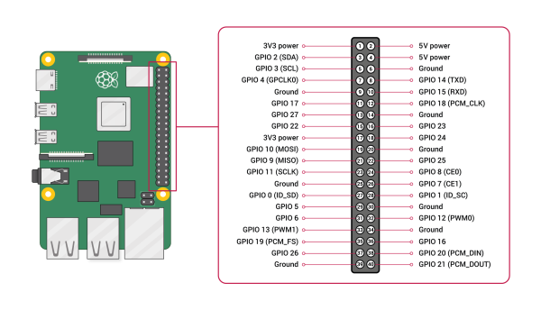
Raspberry Pi 4 Model B Pinout:

Slide 3
Components
Here we provide a list of the components (and their quantity) required to assemble the electronics:
Electronic Components:
Breadboard (x1)
Jumper wires (male to female) (x12)
Jumper wires (female to female) (x15)
Female DC power adapter (Jack to screw terminal) (x1)
Male DC power adapter (Jack to screw terminal) (x1)
WS2812B LED array + box (x1)
ULN2003 driver board (x3)
Camera Components:
Note. These components are dependent
on what camera you use.
USB 3.0 A to right-angle micro-B cable (x1)
8-pin Hirose cable (x1)
USB 3.0 CMOS monochromatic camera (x1)
Raspberry Pi Components:
Raspberry Pi 4 model B
Raspberry Pi housing
Heatsink (optional)
Misc. Components:
2.5 mm Phillips screwdriver
Electrical tape
Wire stripper
Scissors

Slide 4
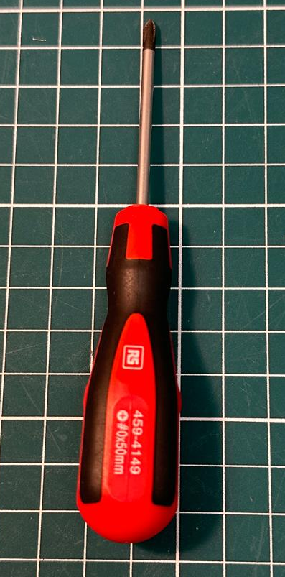
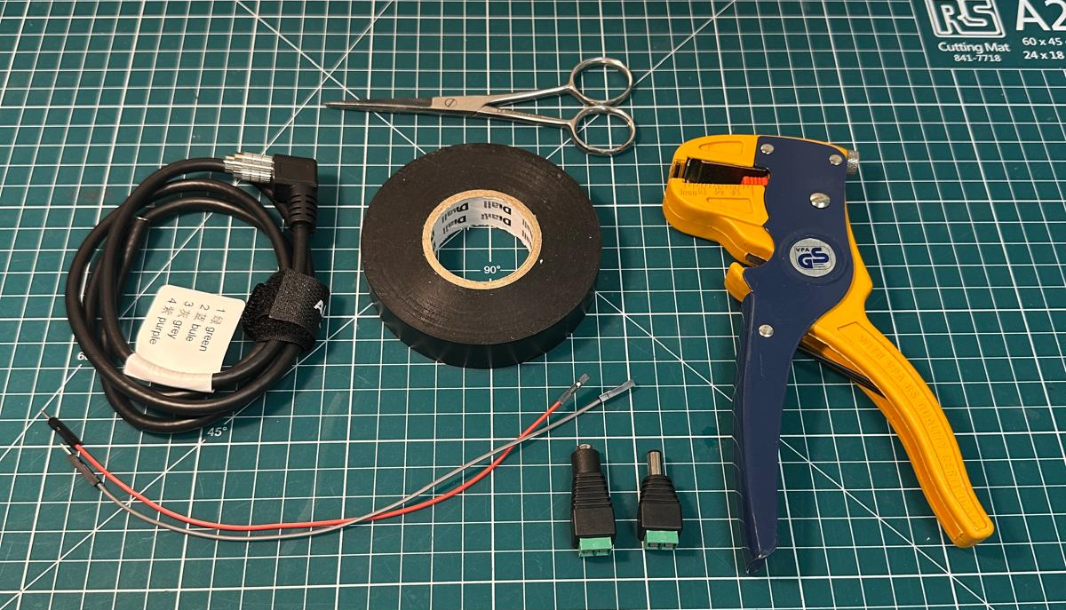
Step 1(a)
What you will need:
8-pin Hirose cable (x1)
Jumper wires (male to female) (x2)
Female DC power adapter (Jack to screw terminal) (x1)
Male DC power adapter (Jack to screw terminal) (x1)
Wire stripper
Scissors
Electrical tape
2.5 mm Phillips screwdriver

Slide 5
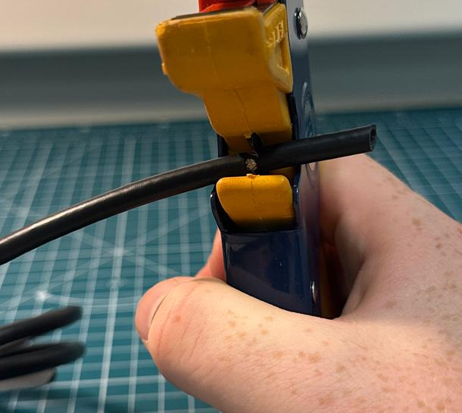
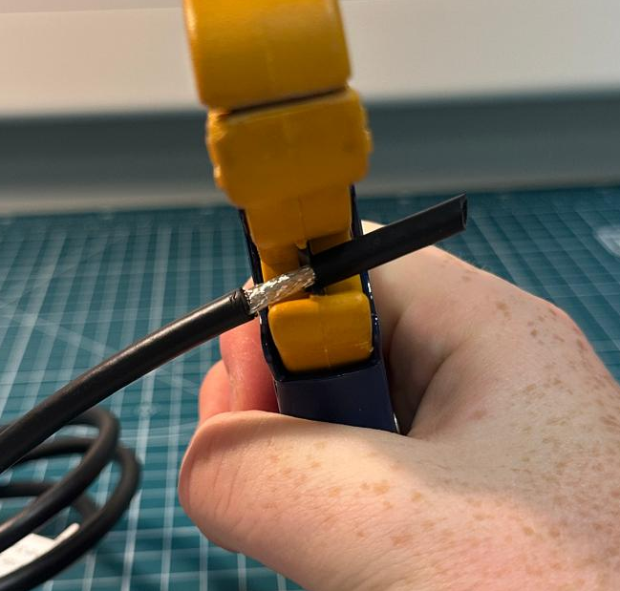
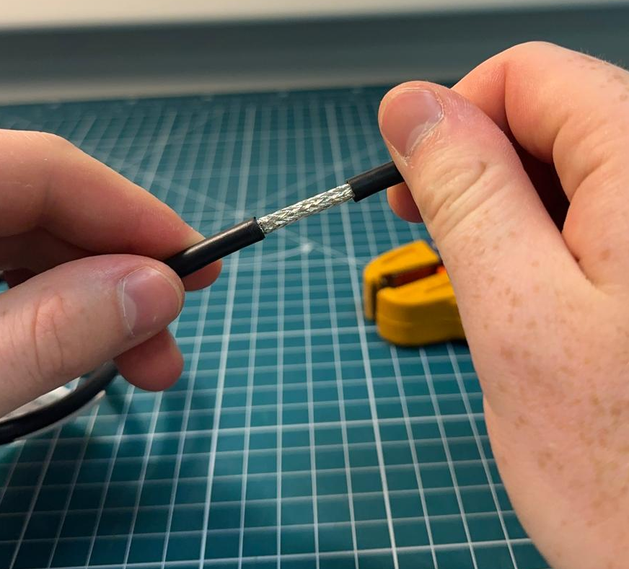
Step 1(b)
TODO:
Place the terminated end of the 8-pin Hirose cable into the wire stripper.
Carefully, apply pressure and gradually rotate the wire to aid stripping off around 1-2 inches of rubber coating from the cable.
Once fully cut, remove the sleeve of rubber coating to expose the metal wire shielding.

Slide 6
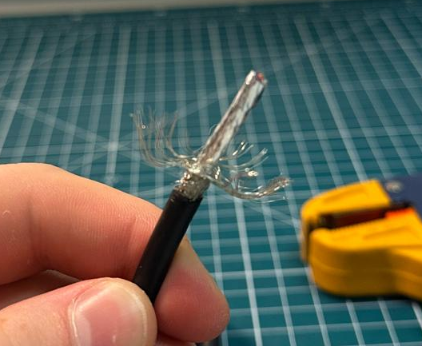
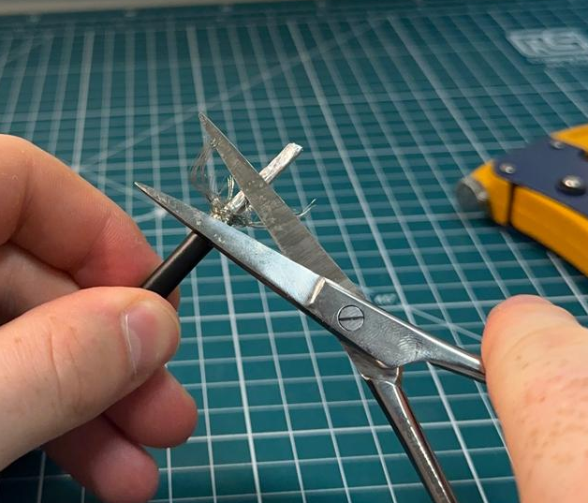
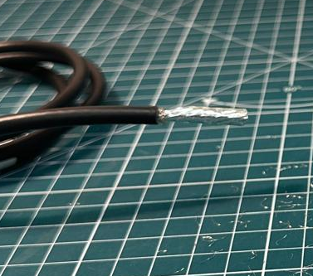
Step 1(c)
TODO:
Now, unravel the wiring. (Wiring is sharp - be careful!)
Use the scissors to trim away as much wire as possible.
You should now be left with the remaining metal foil shielding.

Slide 7
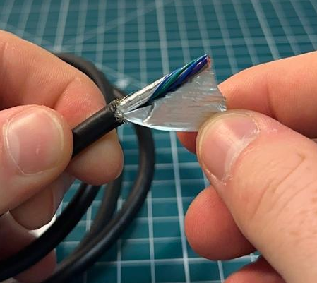
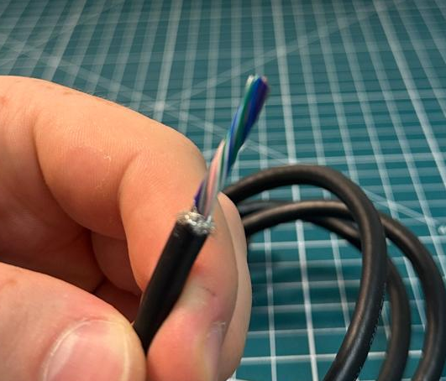
Step 1(d)
TODO:
Remove the metal foil from the cable. (Scissors can be used to create a tear).
The 8 coloured cables should now be exposed, as seen in the right-side image.

Slide 8
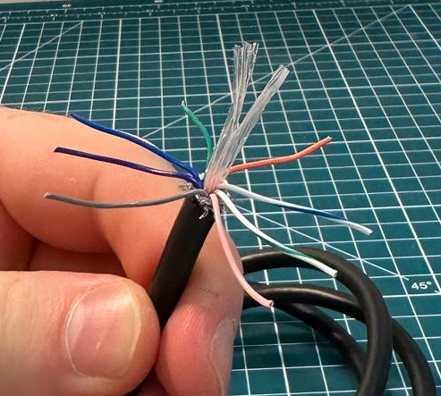
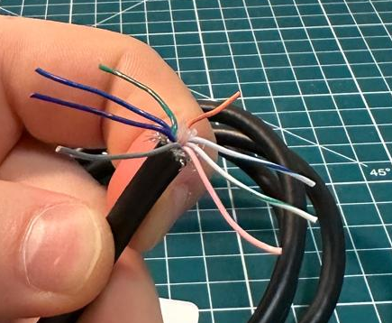
Step 1(e)
TODO:
Now separate out each individual wire. This will expose a core filler material (transparent fibres).
Use the scissors to cut out these fibres at the base.

Slide 9
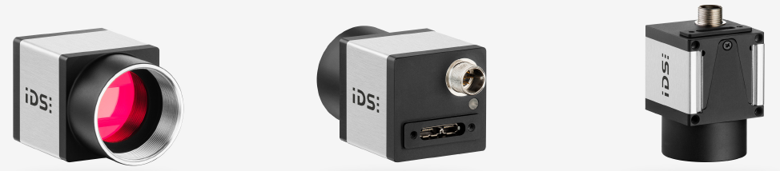
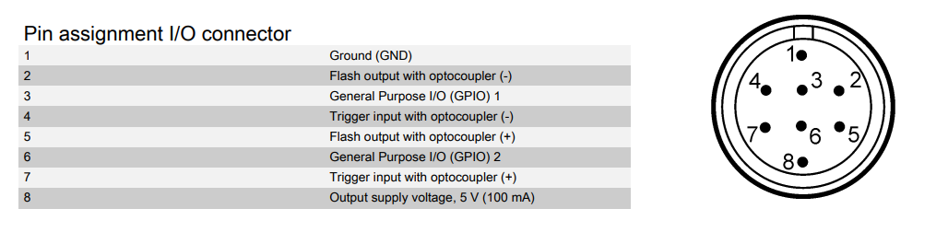
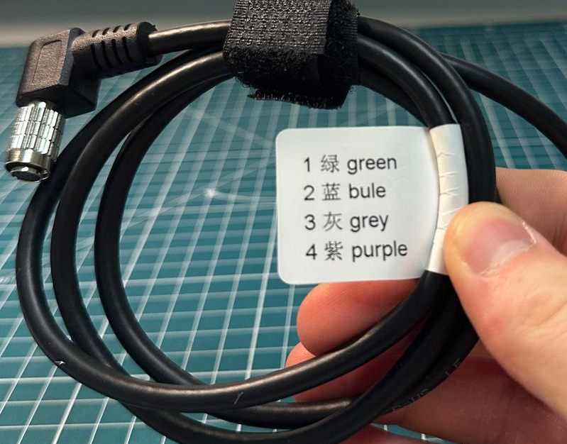
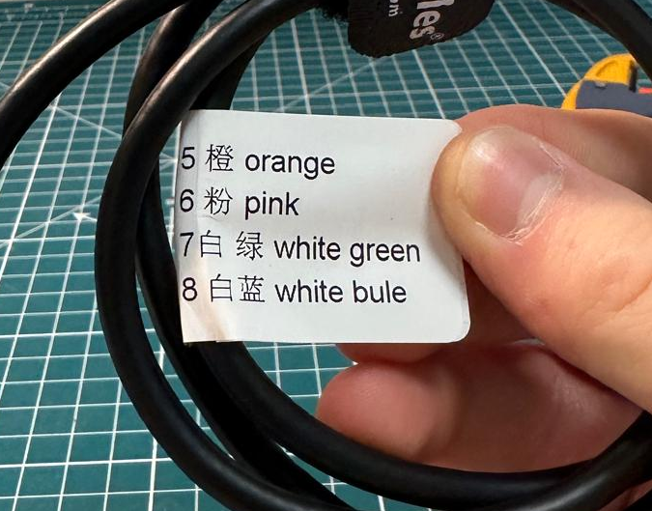
Step 1(f)
TODO:
Depending on the camera (and cable) used, each connector pin (wire) will correspond to an assigned I/O connector which can be identified on a manufacturers data sheet online.
The provided iDS camera pin assignment I/O connector table shows that, for triggering the camera, a signal must be sent to the optocoupler over pin 7 (+) and grounded using pin 4 (-).
For the Hirose cable, a label attached identifies the cable numbers and colours (pin 4 - purple) and (pin 7 – white-green).

Slide 10
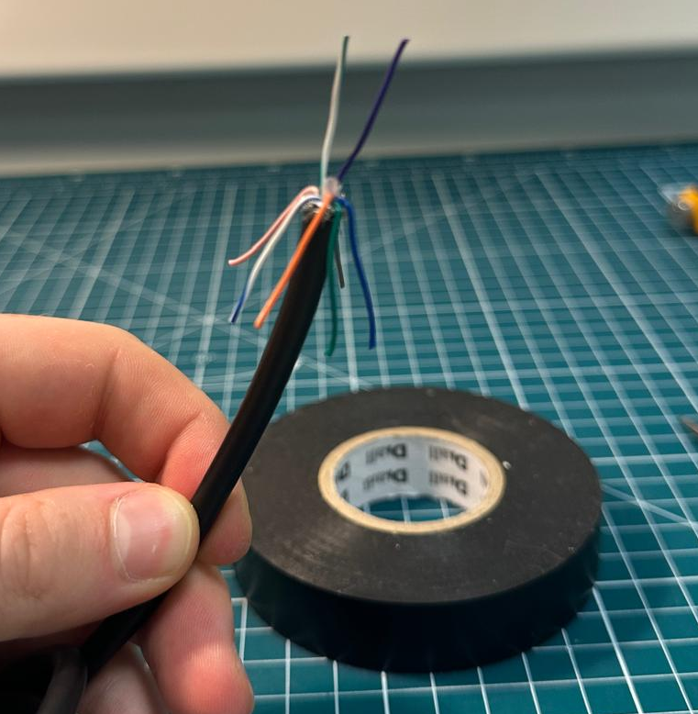
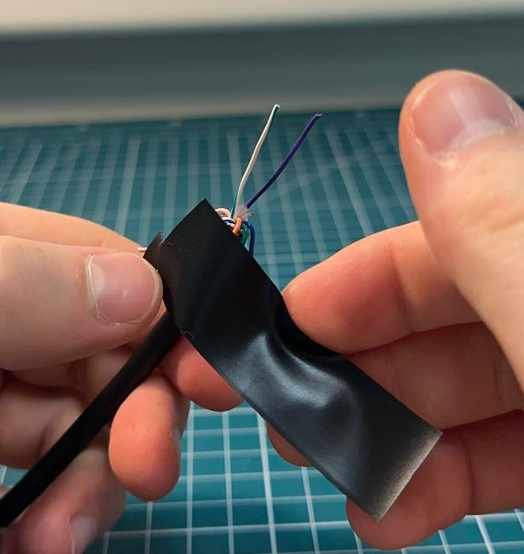
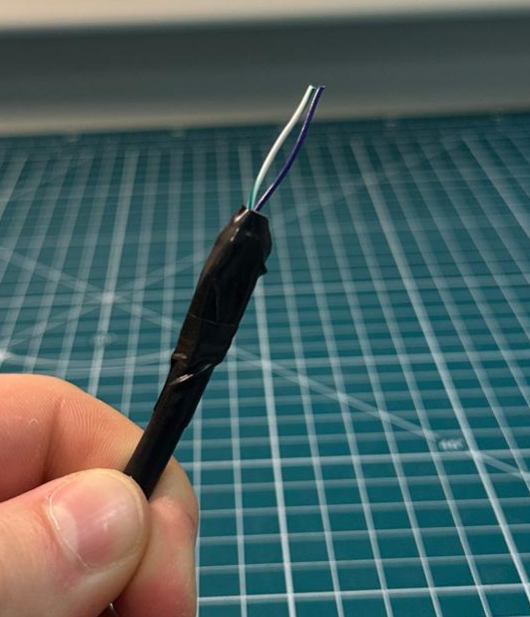
Step 1(g)
TODO:
We can now separate the purple and white-green wires.
Use the electrical tape and scissors to cover the remaining 6 wires.
Once fully covered the purple and white-green wires should be isolated, as seen in the right-side image.
1)
2)
3)

Slide 11
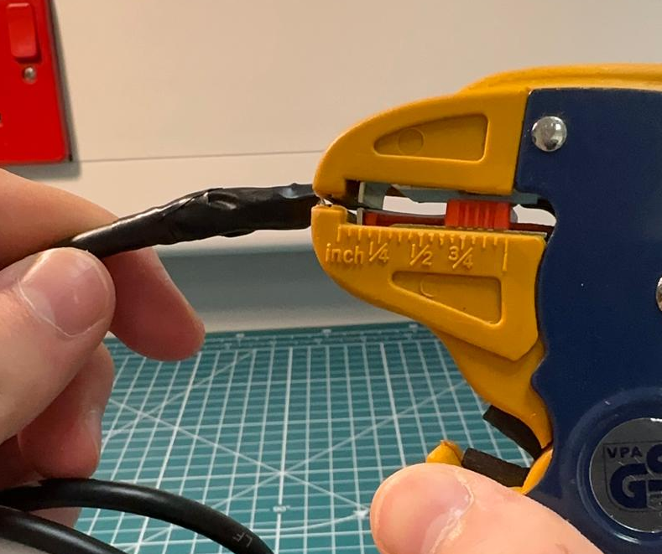
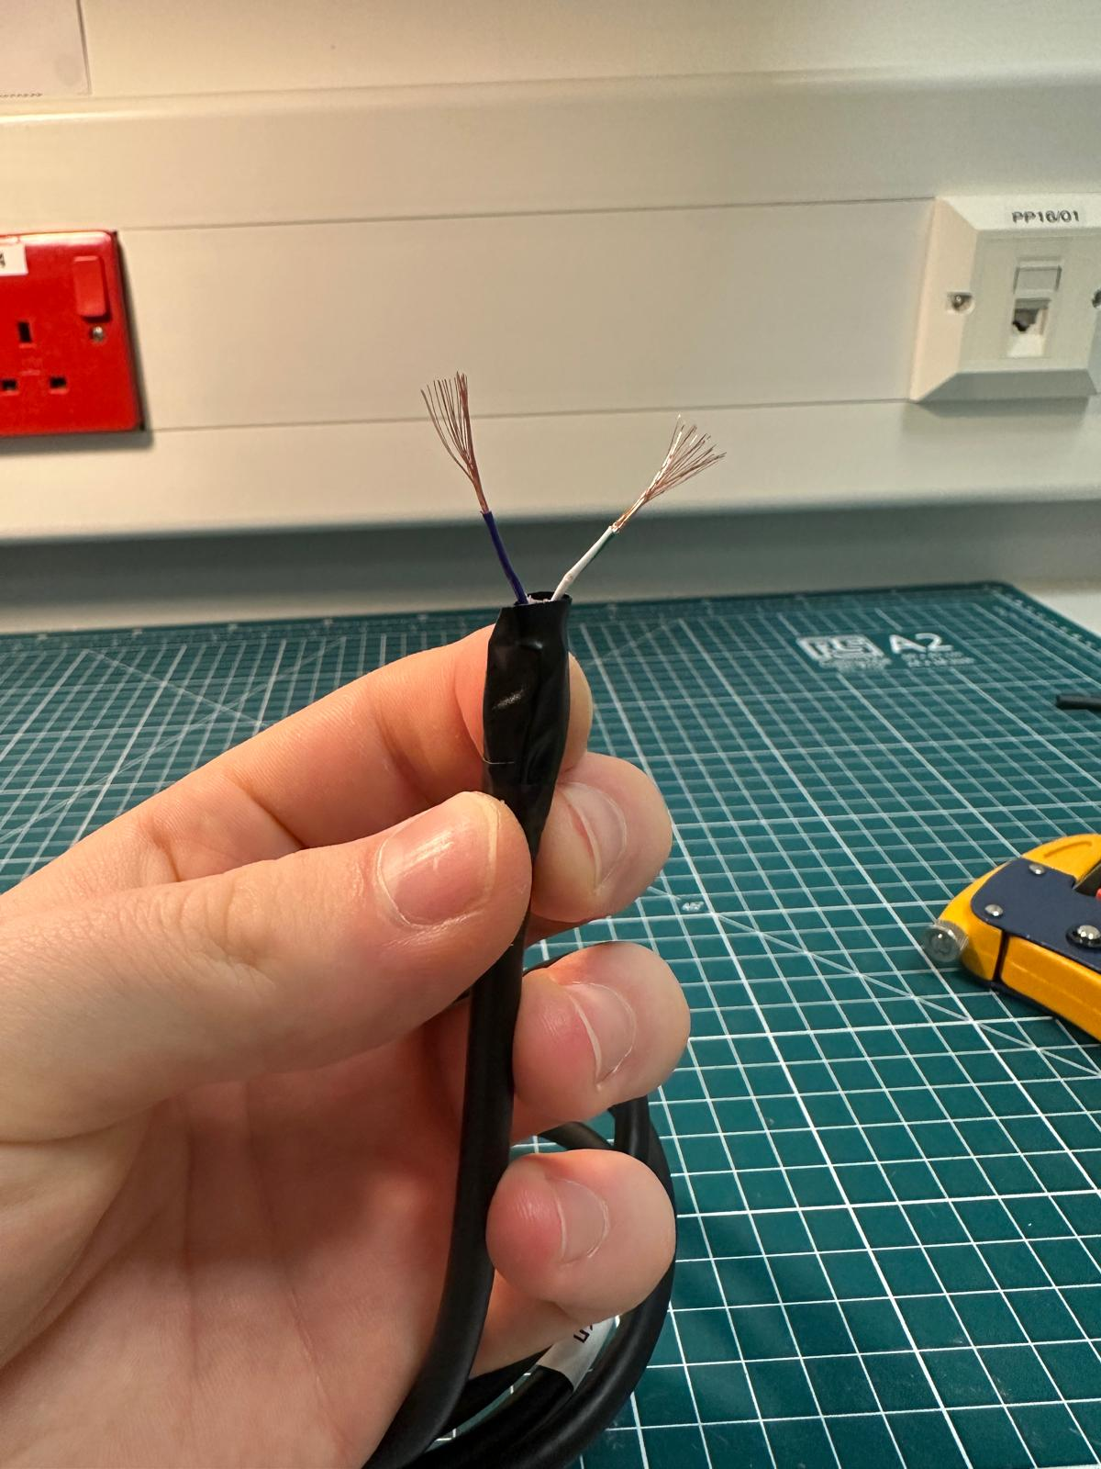
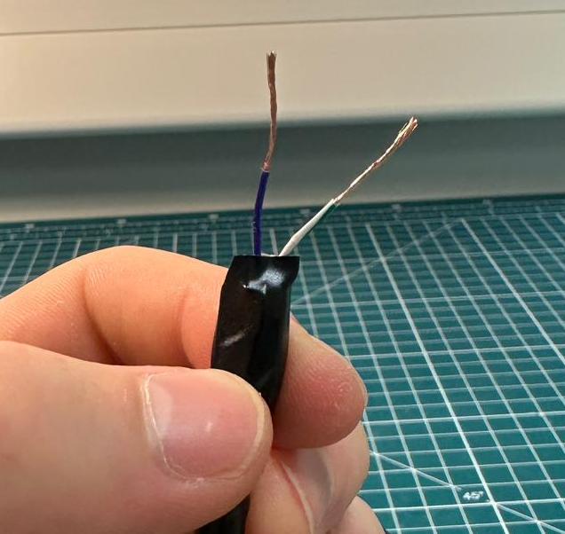
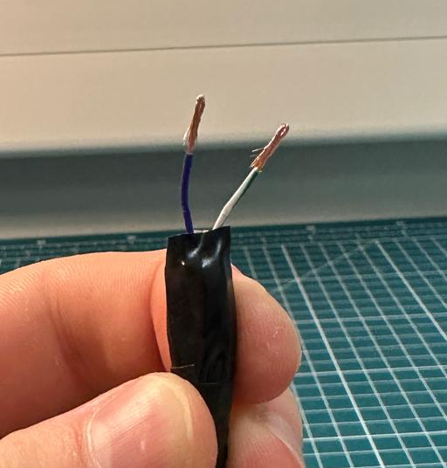
Step 1(h)
TODO:
Next, each of the two wires can be stripped using the wire stripper, exposing the metal wiring.
After removing the rubber sleeve, the wiring will be flared.
By hand, twist the wiring repeatedly to straighten.
Lastly, fold/double the wires back on themselves to create a thicker and shorter contact point.
1)
2)
3)
4)

Slide 12
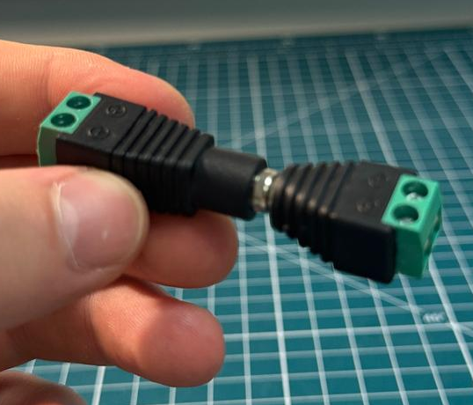
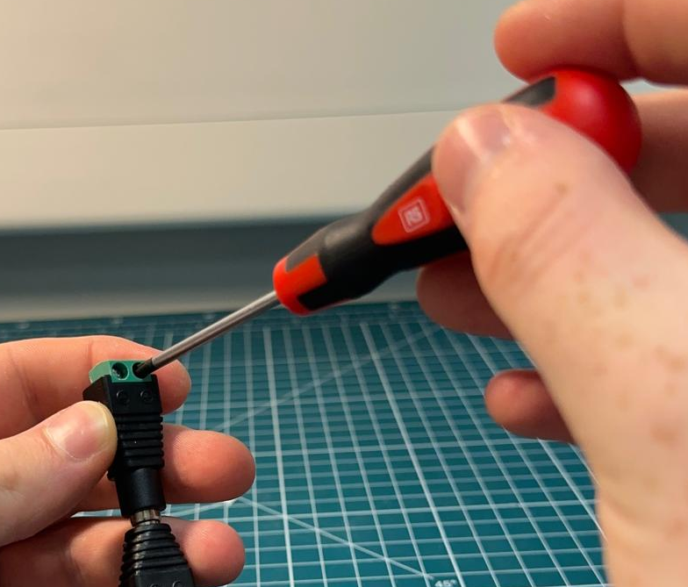
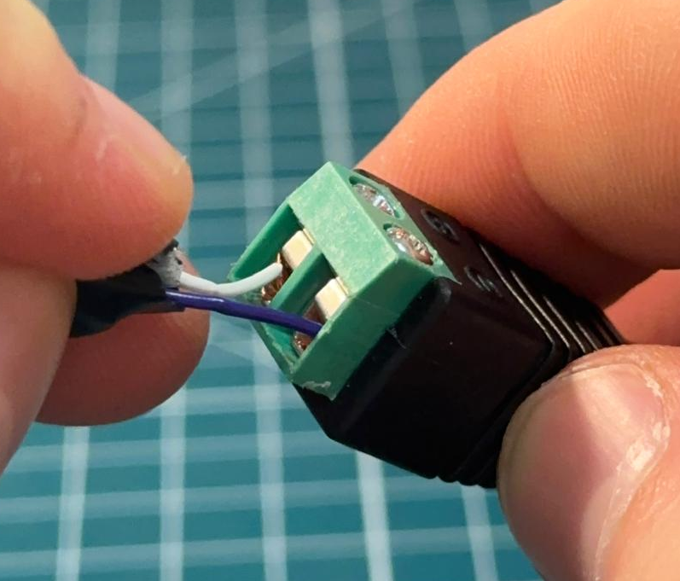
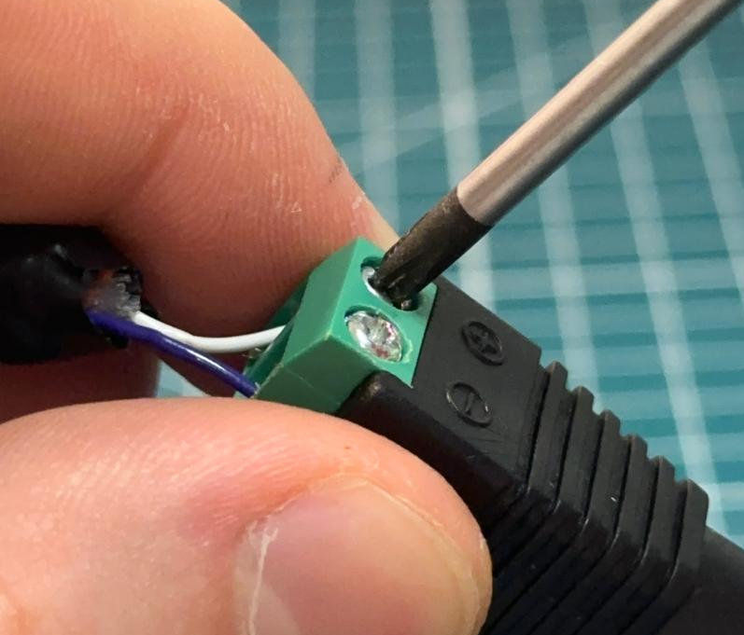
Step 1(i)
1)
2)
TODO:
Connect the female to male DC power adapters.
Unscrew the (+) and (-) screws from one of the terminal blocks.
From Step1(f):
  Pin 7 white-green goes to the (+) terminal
  Pin 4 purple goes to the (-) terminal.
Tighten down the screws to clamp the wires into the terminal block.
3)
4)

Slide 13
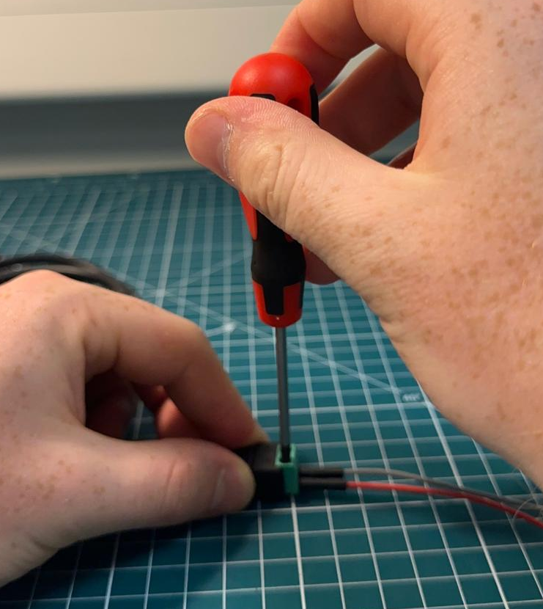
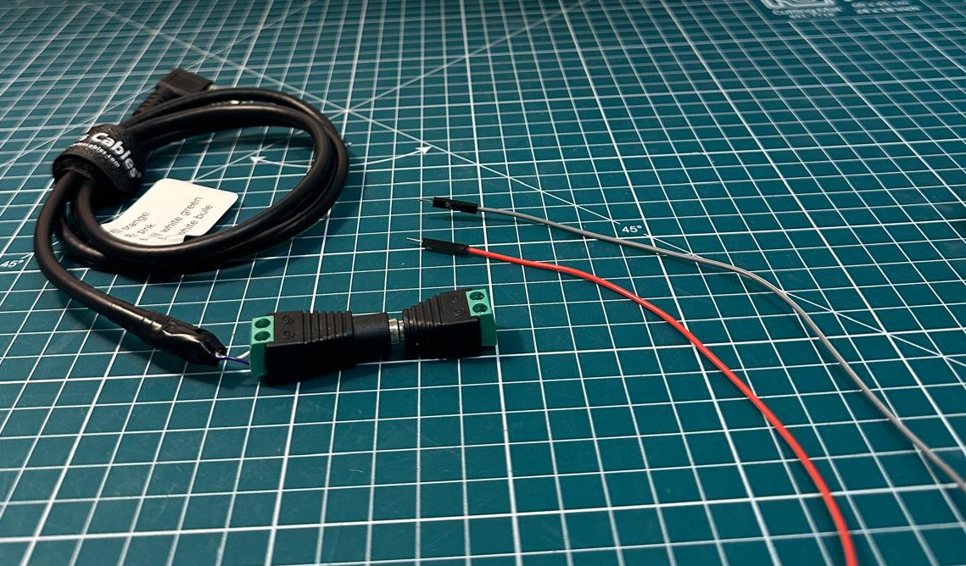
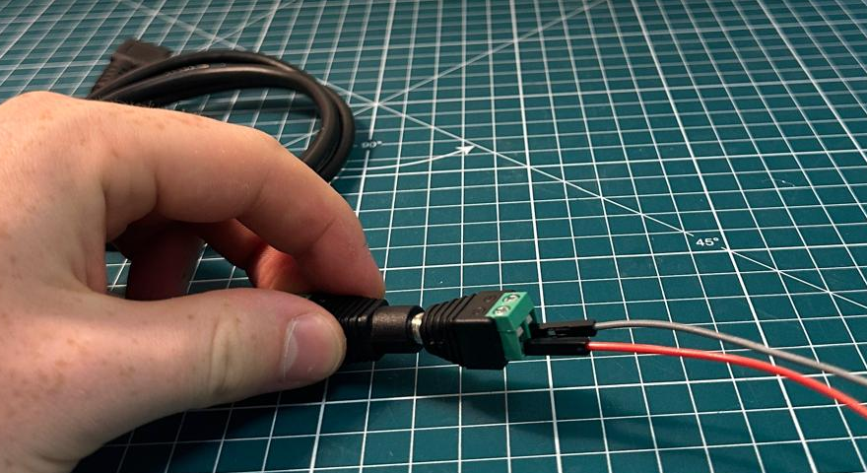
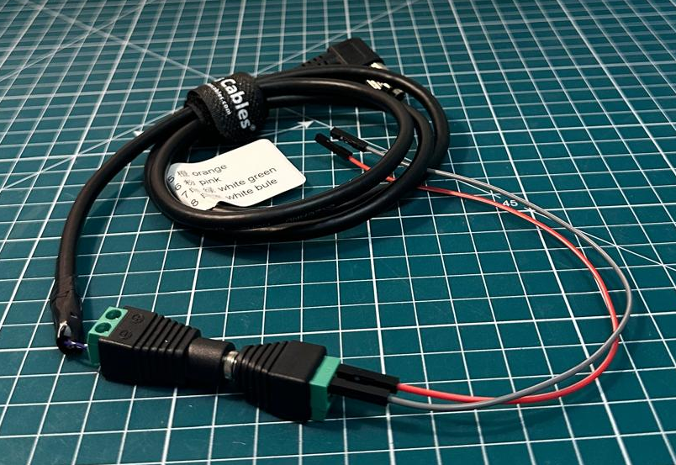
Step 1(j)
TODO:
We can now complete the other terminal block which will connect to the GPIO pins on the Raspberry Pi.
Similarly to the previous step, unscrew the (+) and (-) screws from the terminal block.
Here, the red wire is connected to the (+) terminal and the grey wire is connected to the (-) terminal.
Tighten down the screws to clamp the wires into the terminal block.

Slide 14
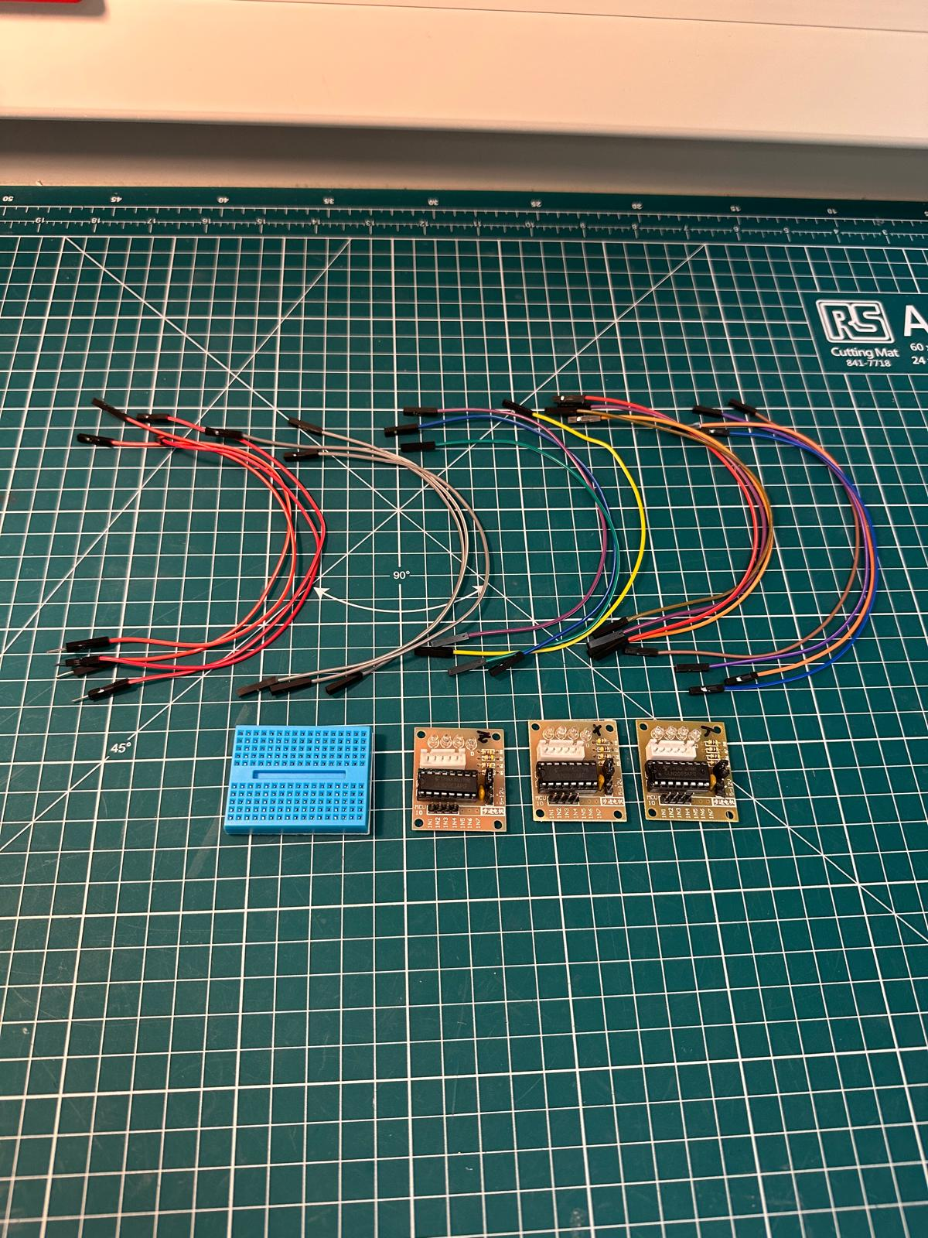
Step 2(a)
What you will need:
Jumper wires (male to female) (x4) (preferably red)
Jumper wires (female to female) (x15) (3 grey, 12 any colour)
Breadboard (x1)
ULN2003 driver board (x3)
Note:
We recommend marking these driver boards X, Y and Z.
Later, this will help us determine which board is associated to which stepper motor.

Slide 15
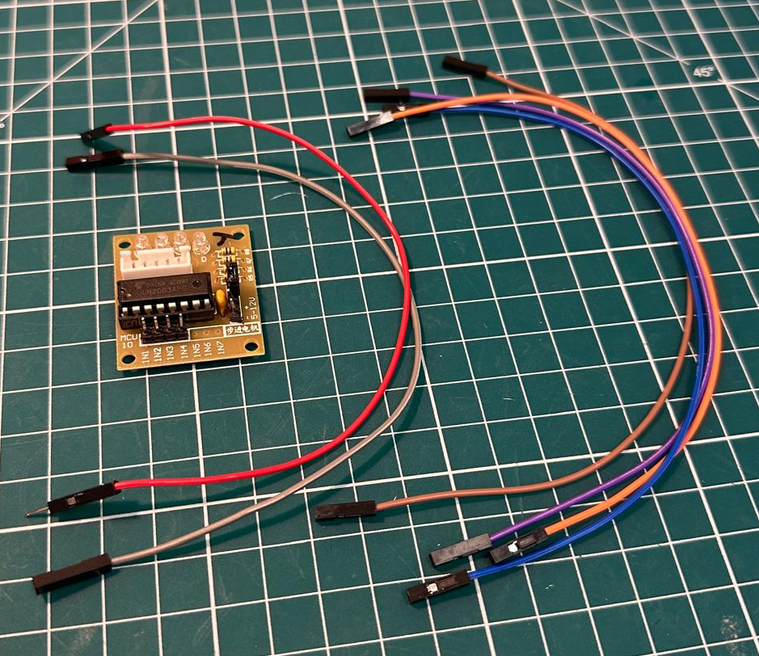
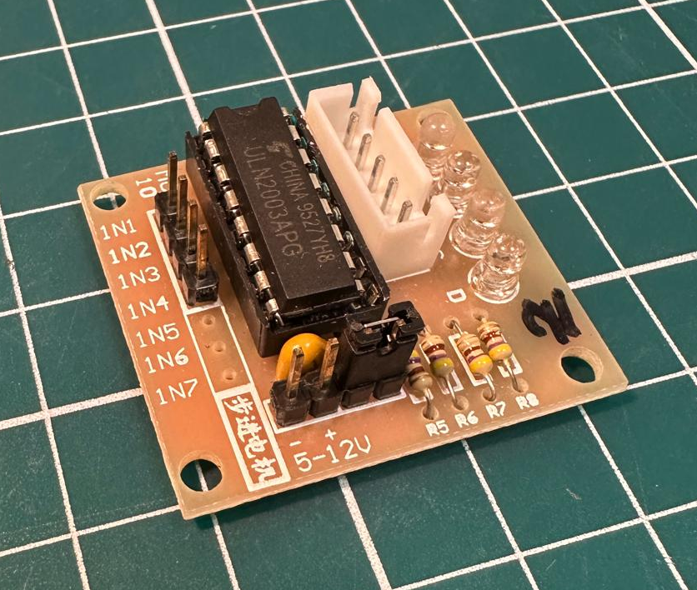
Step 2(b)
TODO:
Take 1 red wire (male to female), 1 grey wire (female to female) and 4 wires any colour (female to female).
We now want to wire up the following 6 pins on a driver board:
  IN1, IN2, IN3, IN4
  (+) Pin, (-) Pin
Note:
For the next few steps, it does not matter which driver board you use, or in what order. This will only matter from step 4(c) onwards.

Slide 16
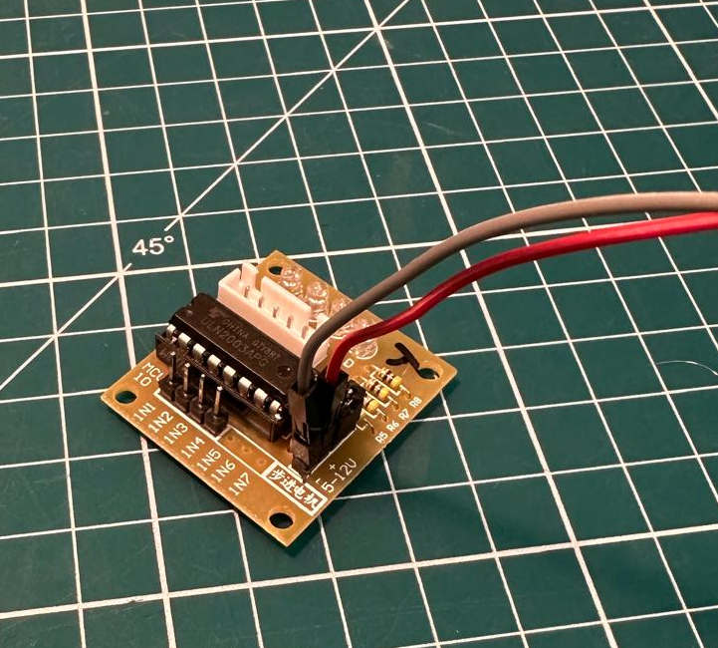
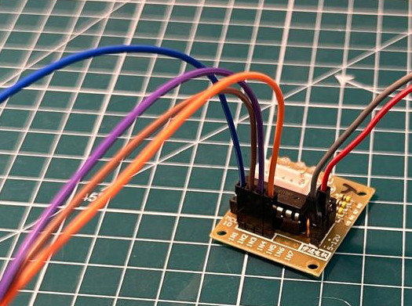
Step 2(c)
TODO:
First, connect the red wire (male to female) to the (+) pin, and the grey wire (female to female) to the (-) pin.
Next, connect the remaining 4 wires (female to female) into IN1-IN4.
Note:
Keep note of which wire colours are associated to each pin. This will help with wiring up to the Raspberry Pi later.

Slide 17
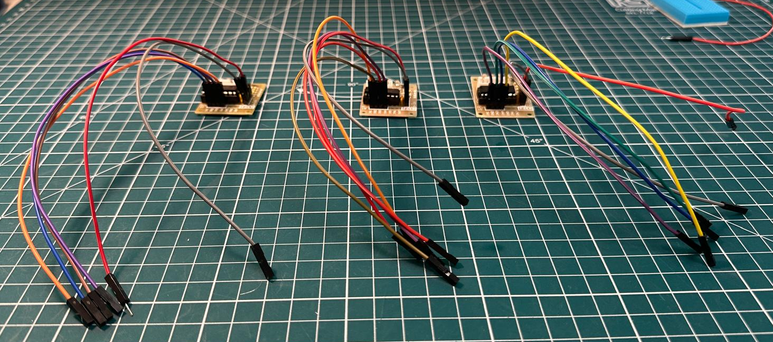
Step 2(d)
TODO:
Now repeat Steps 2(a-c) for the remaining two driver boards.
You should end up with 6 wires coming from each driver board.

Slide 18
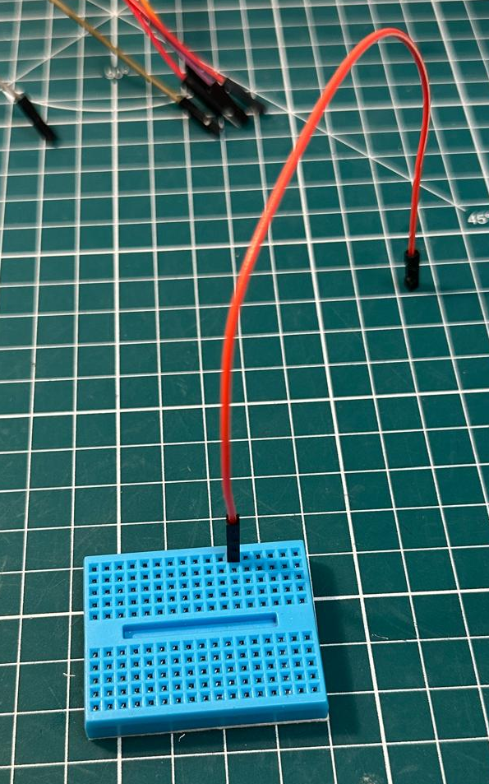
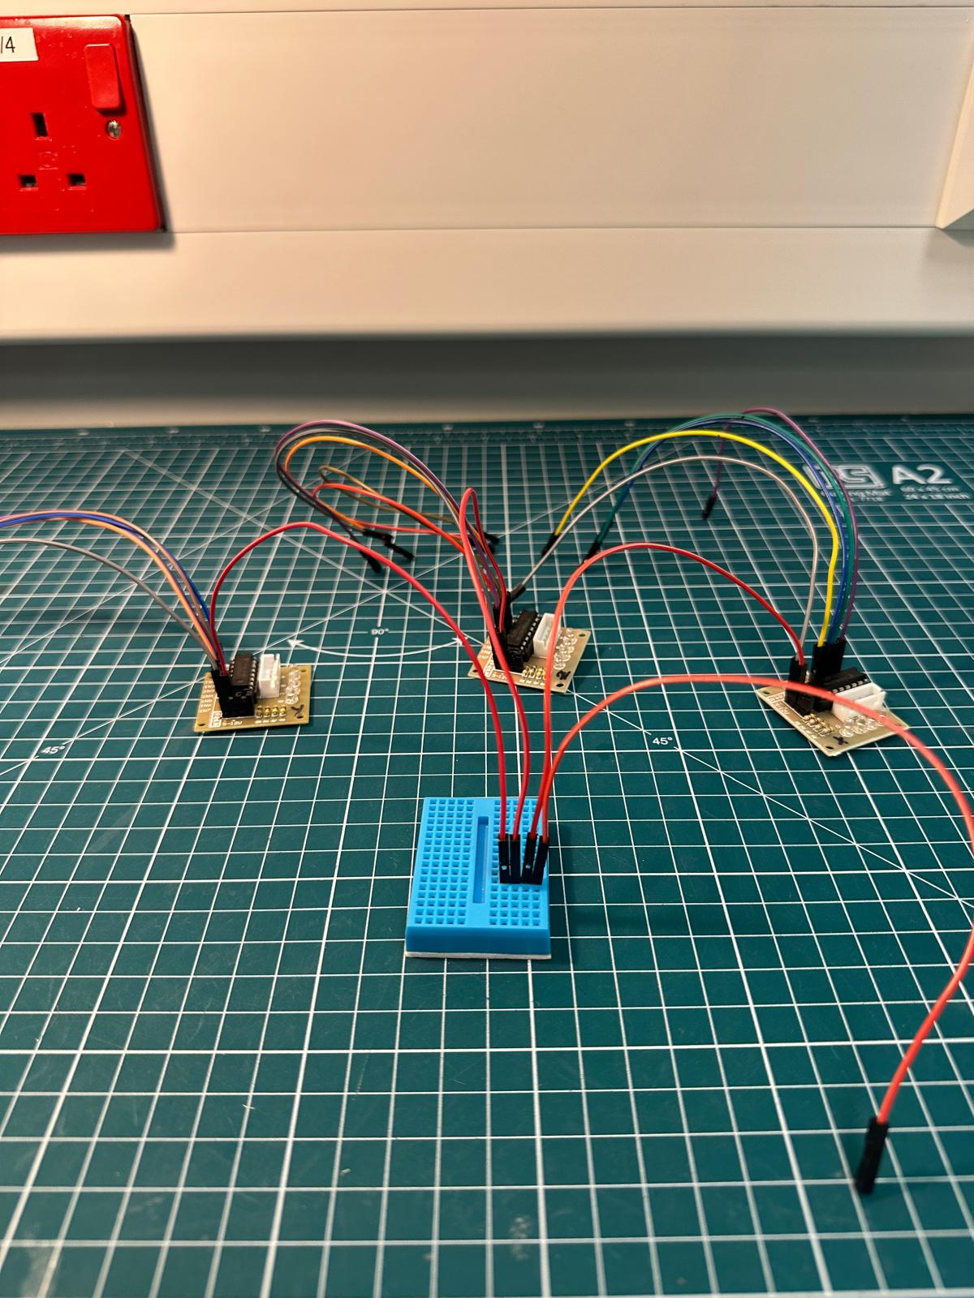
Step 2(e)
TODO:
Now, take the breadboard and connect the last remaining red wire (male to female).
Then, connect all three of the (+) pin wires from the driver boards in series (same row) to the first wire on the breadboard, as seen in the digitally magnified image.
Note:
This is how we will power the drivers, sending 5V from a single Raspberry Pi GPIO pin.
The ordering of these wires in the breadboard does not matter.

Slide 19
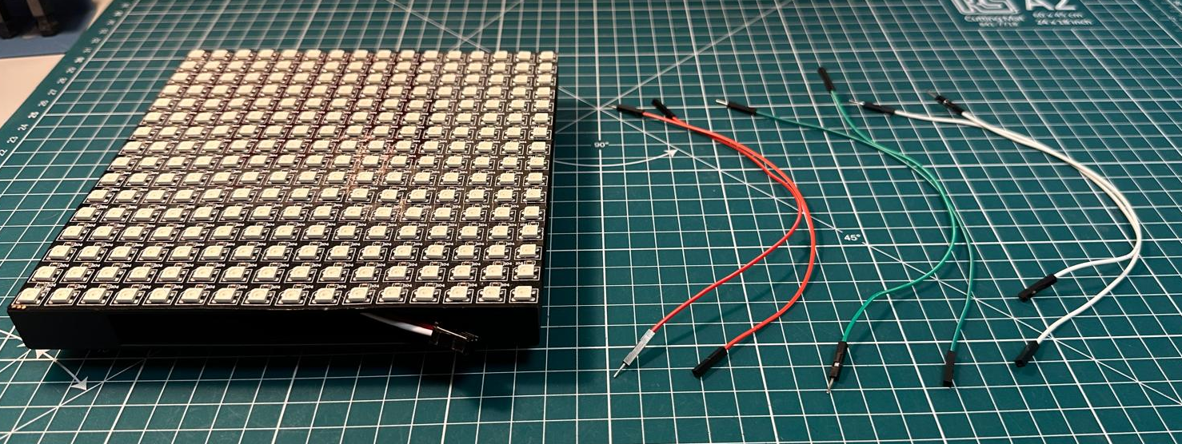
Step 3(a)
What you will need:
WS2812B LED array + box
Jumper wires (male to female) (x6) (preferably 2 red, 2 green and 2 white for consistency).

Slide 20
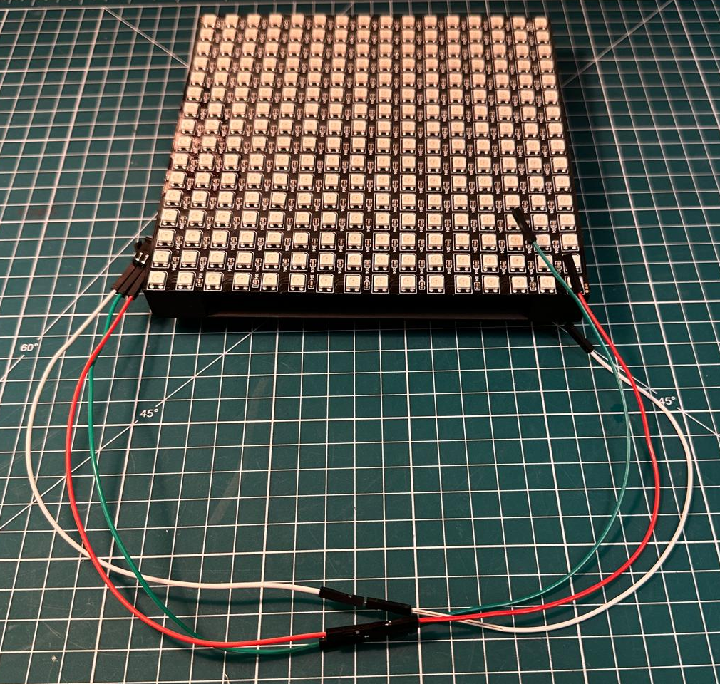
Step 3(b)
TODO:
First, connect each pair of coloured wires.
You should now have 3 long wires.
Now, connect the 3-pin female connector on the back of the LED array to the associated colour wires.
Note:
GND = White
5V power = Red
Signal = Green

Slide 21
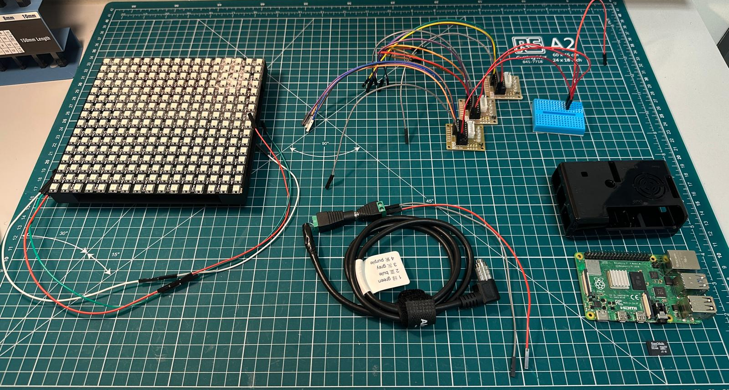
Step 4(a)
What you will need:
LED array wiring
Camera trigger wiring
Driver board wiring
Raspberry Pi 4 model B
SD card
Raspberry Pi housing

Slide 22
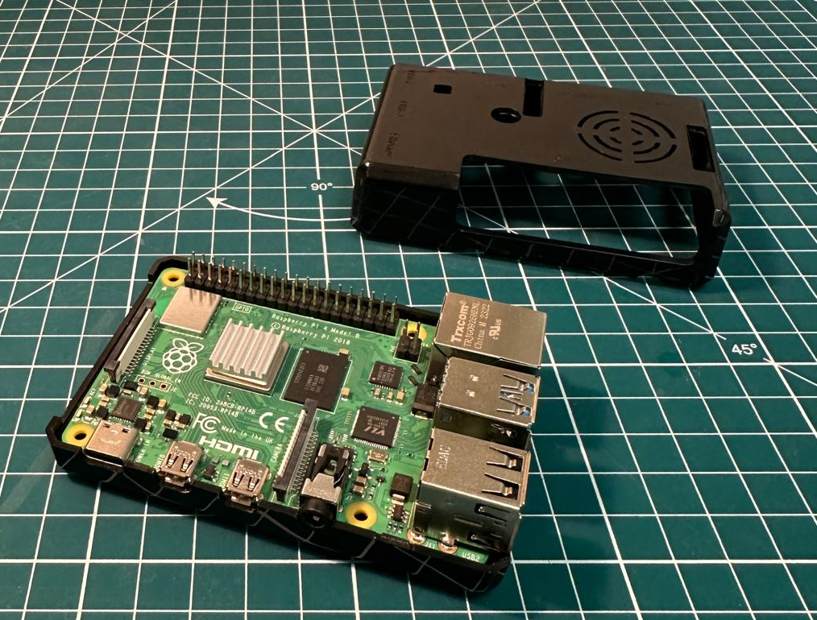
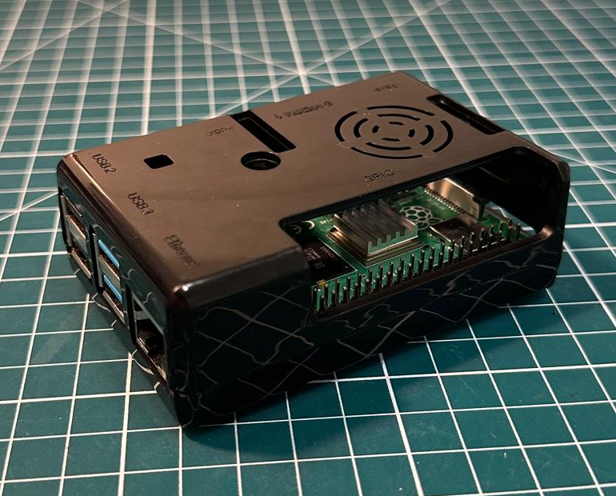
Step 4(b)
TODO:
Insert the Raspberry Pi into the bottom housing. You should hear it click in place at the corners.
Once the Pi is secured in its housing, attach the roof.
Note:
We placed a heatsink on this Raspberry Pi to help keep the temperature low. (Optional)

Slide 23
Step 4(c)
DB – Driver Board
IN - INPUT
CAM TRI – Camera Trigger
TODO:
Next, we need to connect each wire to a pin on the Pi.
On the right is a labelled schematic showing where each wire will be connected to on the Pi.
You can use this as a guide going through Steps 4(d-j).
Note:
DB 1 = X
DB 2 = Z
DB 3 = Y
- MOTORS
- LED ARRAY
- LED ARRAY
- DB 1 [IN 1]
- DB 1 [IN 2]
- LED ARRAY
- DB 1 [IN 3]
- DB 1
- DB 1 [IN 4]
- DB 2 [IN 1]
- DB 2
- DB 2 [IN 2]
- DB 2 [IN 3]
- DB 2 [IN 4]
- DB 3 [IN 1]
- DB 3
- DB 3 [IN 2]
- CAM TRI
- DB 3 [IN 3]
- CAM TRI
- DB 3 [IN 4]

Slide 24
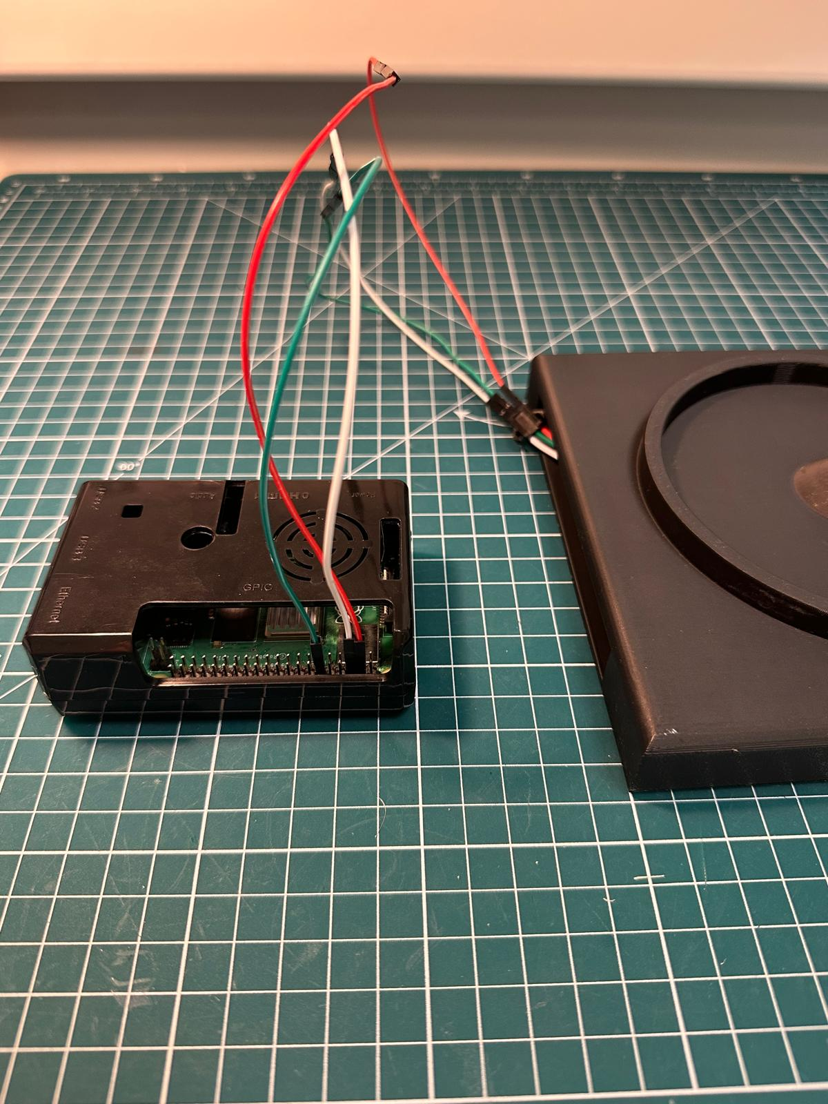
Step 4(d)
TODO:
Take the LED array wires and connect them to the following pins as seen on the schematic:
  Pin 4 (5V power) – Red wire
  Pin 6 (GND) – White wire
  Pin 12 (GPIO 18) – Green wire

Slide 25
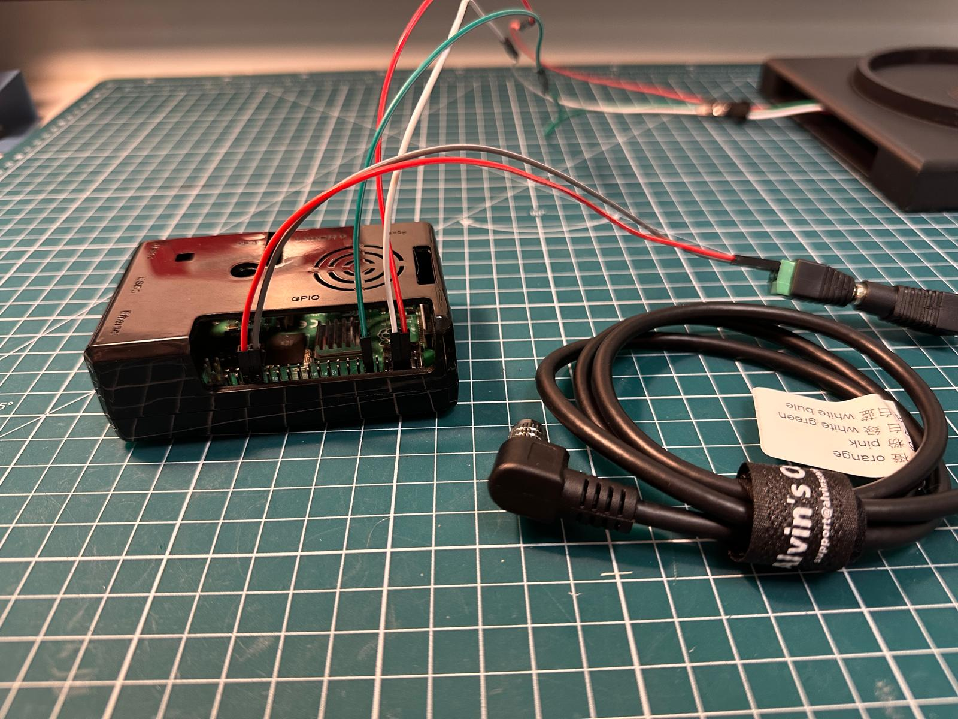
Step 4(e)
TODO:
Now, connect the camera trigger wires:
  Pin 34 (GND) – Grey wire
  Pin 36 (GPIO 16) – Red wire

Slide 26
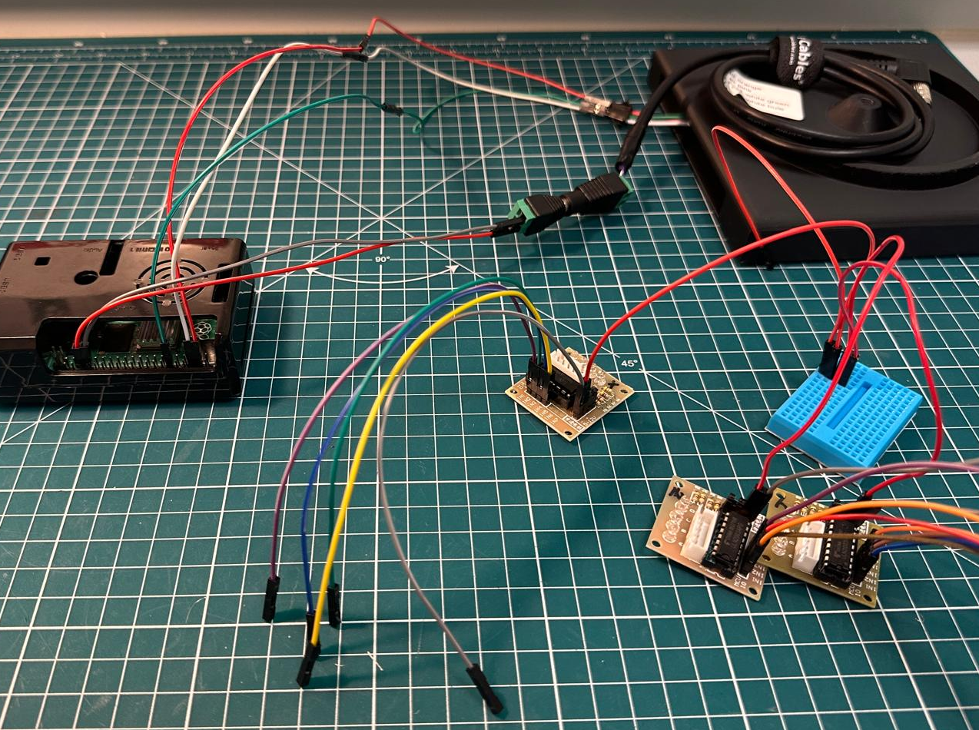
Step 4(f)
TODO:
Next, the driver boards can be connected.
Note:
Be careful with the wiring here.
Deal with each wire one at a time.
Double check that you have connected the correct wire to the correct pin.
It can be easy to mistake a neighbouring pin!

Slide 27
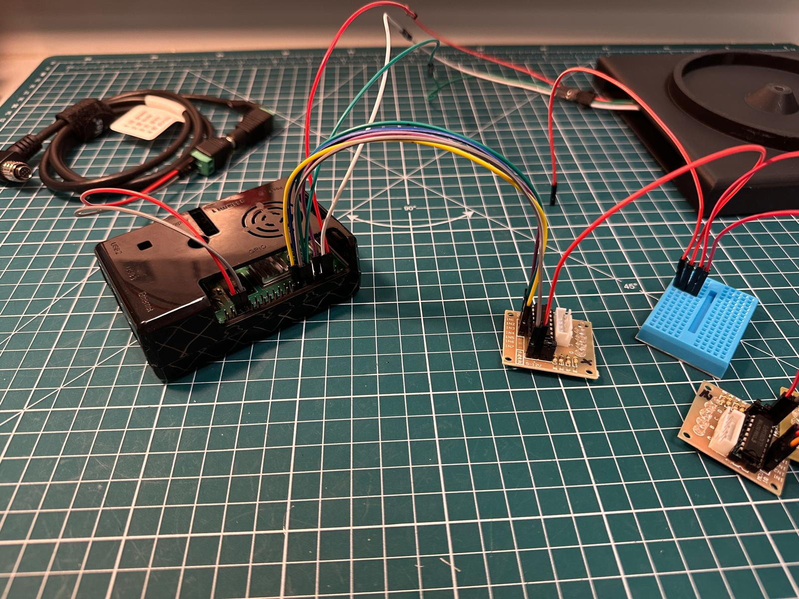
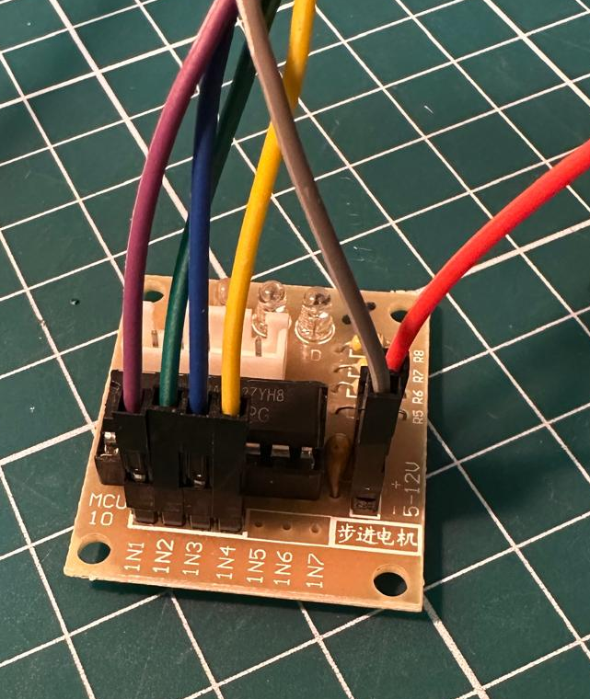
Step 4(g)
TODO:
Select DB 1 which will control the X-motor.
Connect all four channels and the (-) pin:
  Pin 7 (GPIO 4) – Purple wire (IN1)
  Pin 11 (GPIO 17) – Green wire (IN2)
  Pin 13 (GPIO 27) – Blue wire (IN3)
  Pin 15 (GPIO 22) – Yellow wire (IN4)
  Pin 14 (GND) – Grey wire (-)

Slide 28


Step 4(h)
TODO:
Select DB 2 which will control the Z-motor.
Connect all four channels and the (-) pin:
  Pin 19 (GPIO 10) – Orange wire (IN1)
  Pin 21 (GPIO 9) – Brown wire (IN2)
  Pin 23 (GPIO 11) – Red wire (IN3)
  Pin 27 (GPIO 0) – Purple wire (IN4)
  Pin 20 (GND) – Grey wire (-)

Slide 29


Step 4(i)
TODO:
Select DB 3 which will control the Y-motor.
Connect all four channels and the (-) pin:
  Pin 29 (GPIO 5) – Blue wire (IN1)
  Pin 31 (GPIO 6) – Brown wire (IN2)
  Pin 35 (GPIO 19) – Purple wire (IN3)
  Pin 37 (GPIO 26) – Orange wire (IN4)
  Pin 30 (GND) – Grey wire (-)

Slide 30

Step 4(j)
TODO:
The final connection is from the remaining red wire on the breadboard which can be connected into Pin 2 (5V power).
Once all the driver board wires have been connected, the set-up should resemble this image.

Slide 31

Step 5(a)
What you will need:
Microscope assembly
Illuminator assembly
Electronic assembly
Note:
The LED array box has been connected back onto the illuminator canopy.
The Hirose wire has been connected to the camera, attached to the front of the microscope.

Slide 32


Step 5(b)
TODO:
Turn the microscope and illuminator assembly around.
The stepper motor wires should now be visible and close to the driver boards.
Finally, the X, Y, Z labelled stepper motors can now be connected from their wires inside the microscope base to the X, Y, Z labelled driver boards.
Note:
Make sure to connect the correct stepper motor wires.
Stepper motors have 3D printed labels on the back of the microscope.

Slide 33

Step 5(c)
TODO:
The wires can be neatly tucked in, and the microscope hardware assembly is now ready to be used.
The final next steps are to work through the coding assembly instructions.

